Slide 1
Extract, Transform, Load
Movielens Latest Datasets

Slide 2
Introduction
Dataset utilized: MovieLens Latest Datasets
Source: grouplens.org
Description: Dataset provides ratings from over 600 users corresponding to a sample of 9,000 movies. Additional information includes keyword tags, genre categorization, and the release year associated with each movie title.
Files under consideration:
movies.csv
ratings.csv
tags.csv
links.csv

Slide 3
Relevant Queries
Movies database querying:
How many movies were released in a specified timeframe (e.g.2005)? [PostgreSQL]
Being able to get results by querying specified criteria (genre)? [PostgreSQL]
Being able to get results of specified criteria (movie title) [PostgreSQL]
What is the distribution of movies according to genre category(bar chart)? [Pandas]
What is the proportionality of ratings amongst total movies rated (pie)? [Pandas]

Slide 4
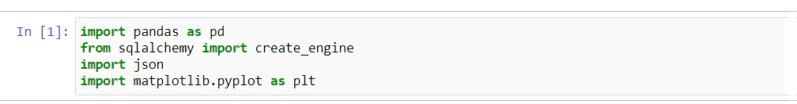
Dependencies in Pandas

Slide 5
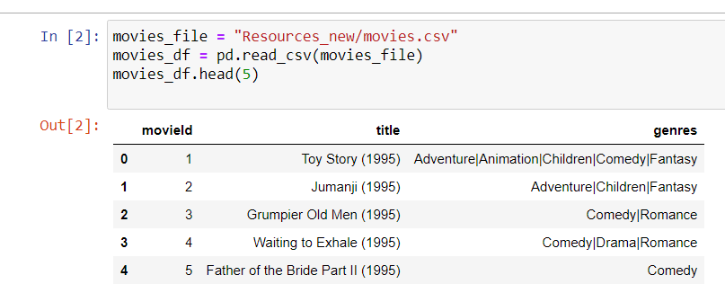
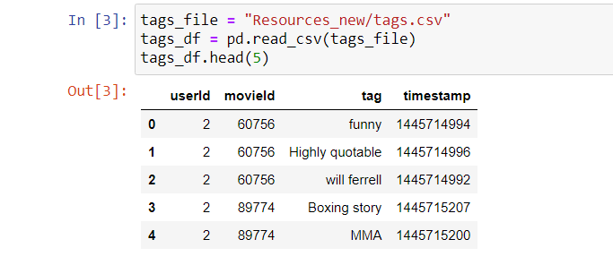
Import csv files into DataFrame: movies csv & tags csv

Slide 6
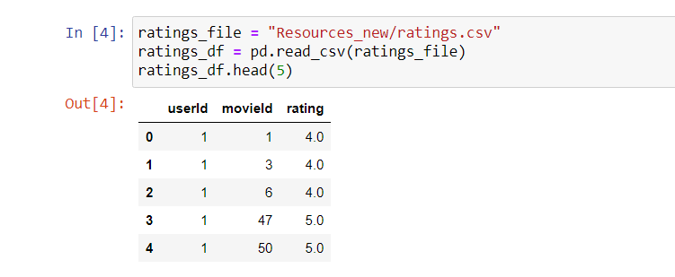
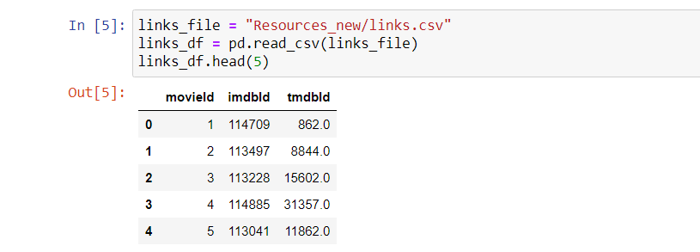
Import csv files into DataFrame: ratings csv & links csv

Slide 7
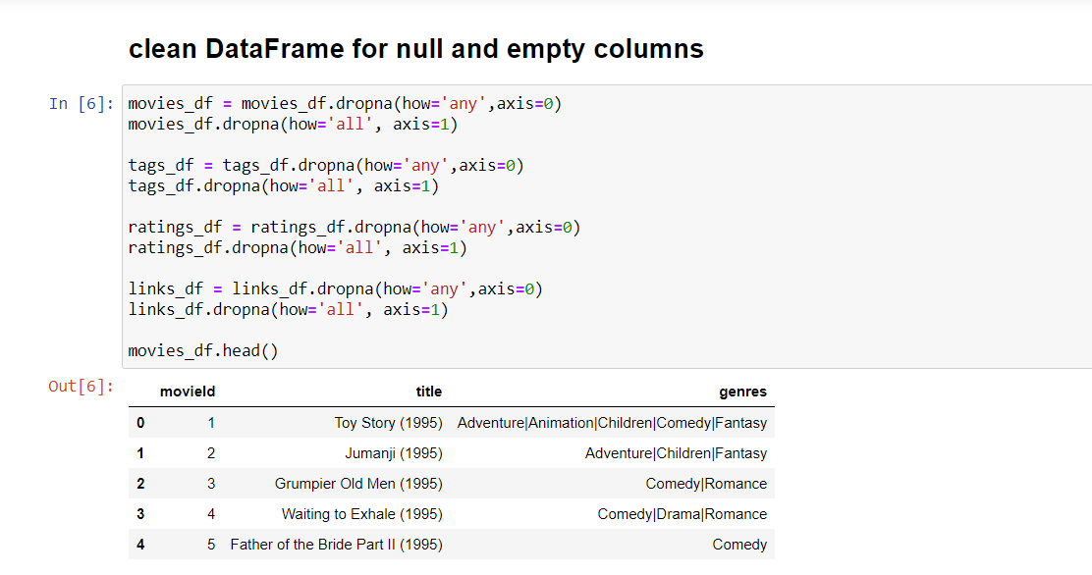
Clean DataFrame for null & empty columns

Slide 8
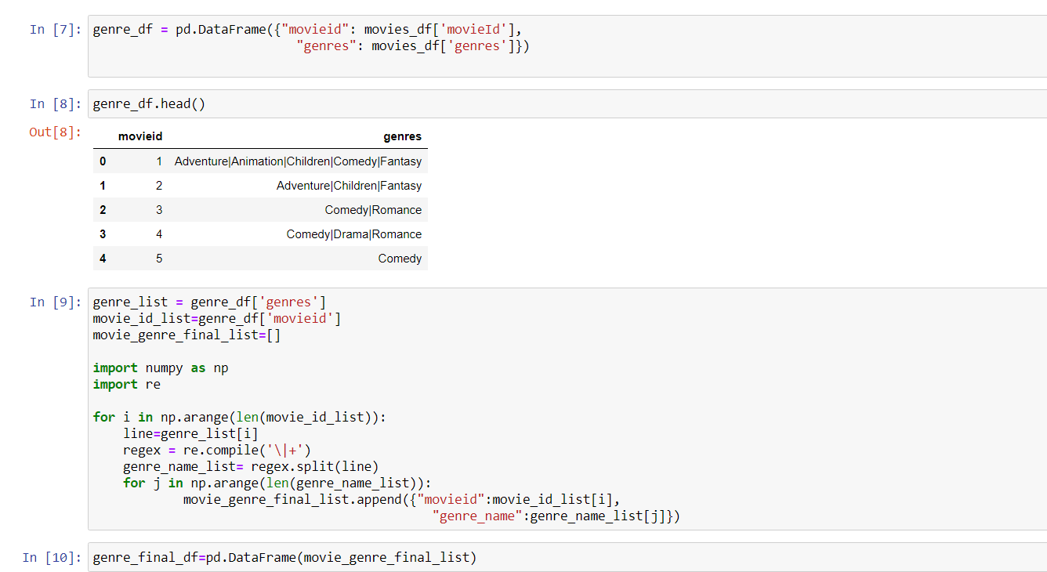
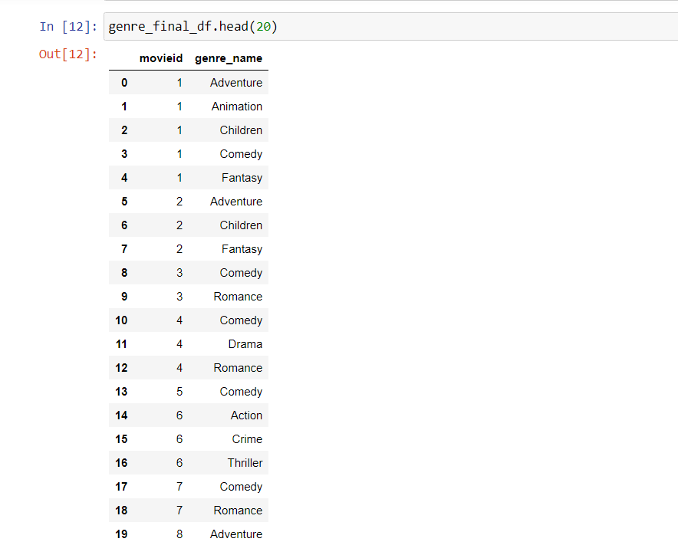
Create a new DataFrame for genre

Slide 9
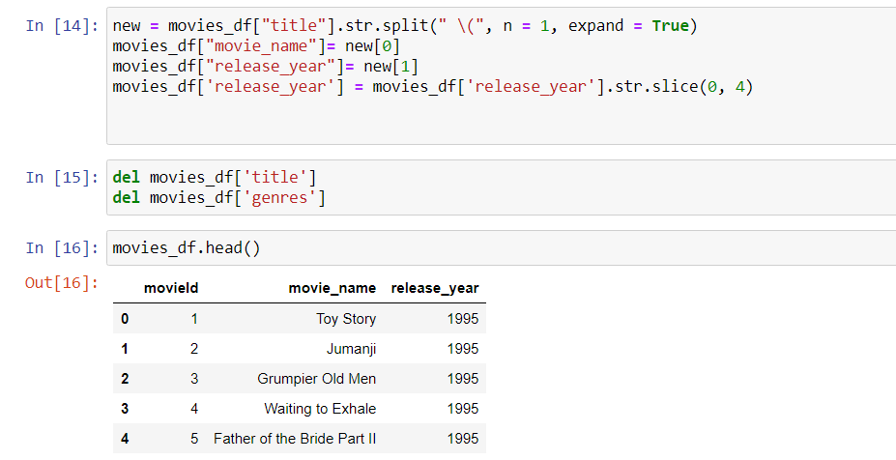
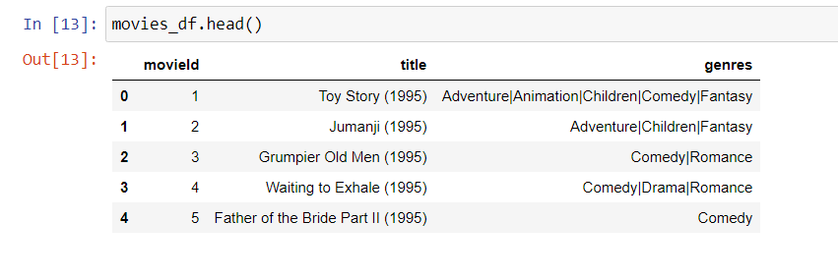
Clean Movies DataFrame

Slide 10
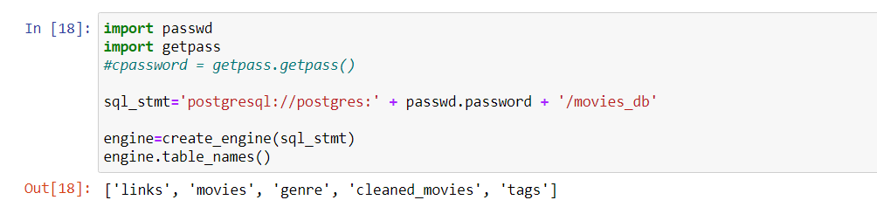
Convert Data Dictionary into DataFrame

Slide 11
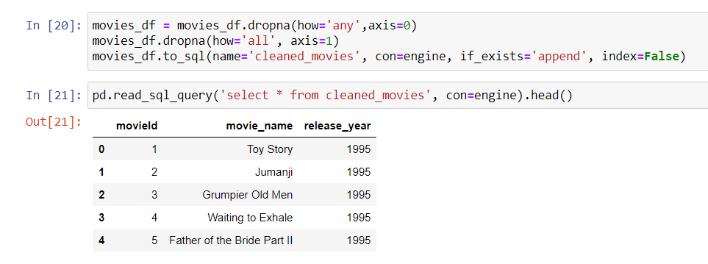
Select * From cleaned_movies

Slide 12
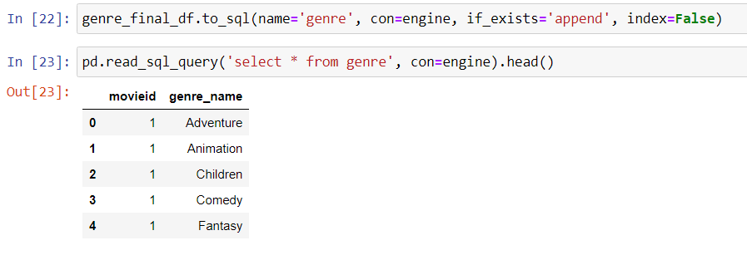
Select * From genre

Slide 13
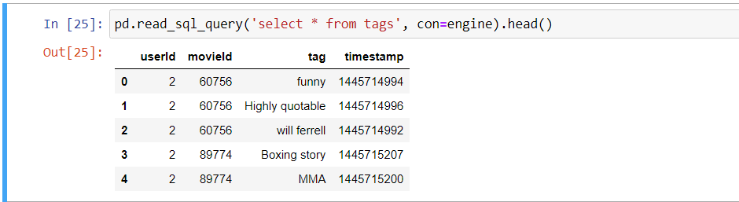
Select * From tags

Slide 14
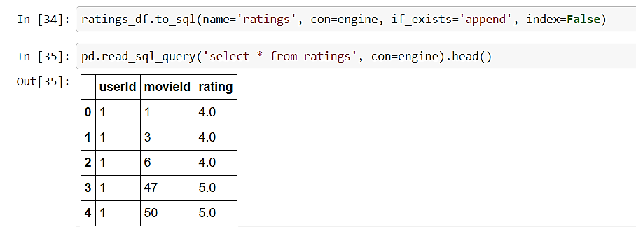
Select * From ratings

Slide 15
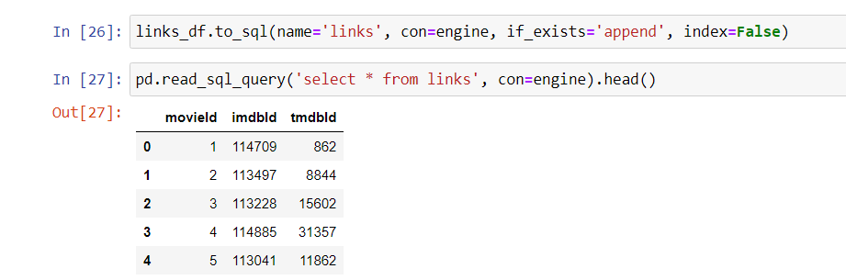
Select * From links

Slide 16
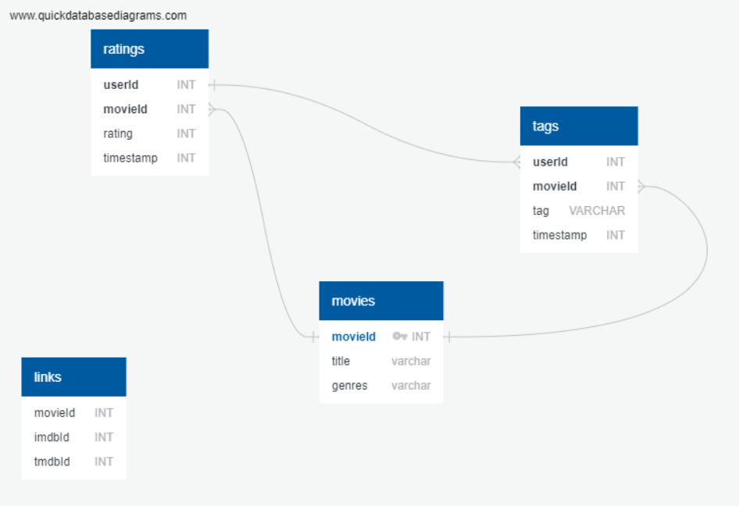
Entity Relationship Diagram (ERD)

Slide 17
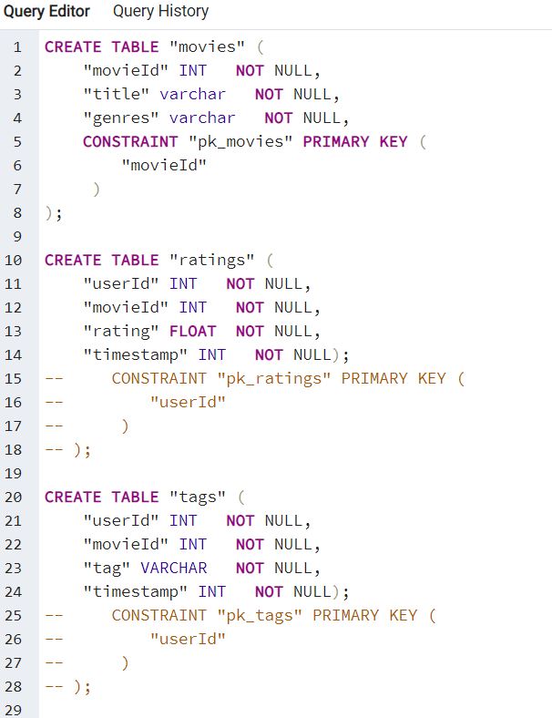
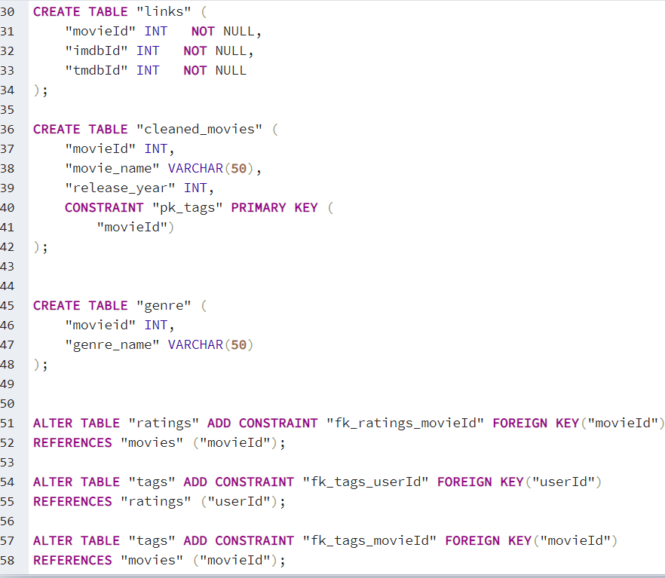
SQL Schema

Slide 18
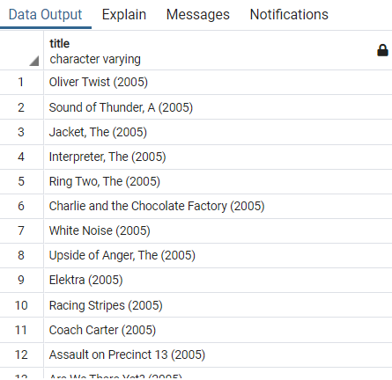
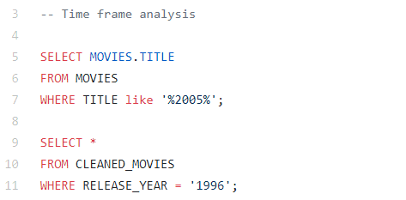
Query Analysis: (1) How many movies were released in a specified timeframe (e.g. 2005)? [PostgreSQL]
Output for 2005

Slide 19
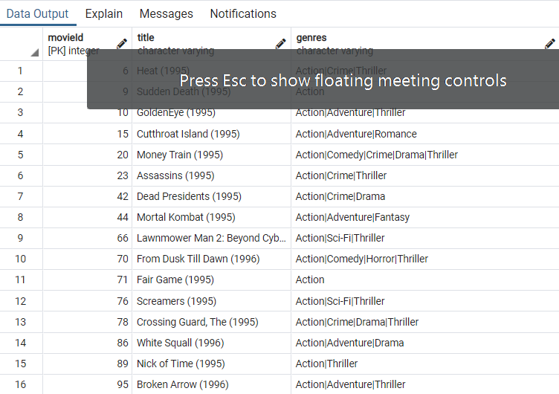

Query Analysis: (2) Being able to get results by querying specified criteria (genre name)? [PostgresSQL]
Output for Action Genre

Slide 20
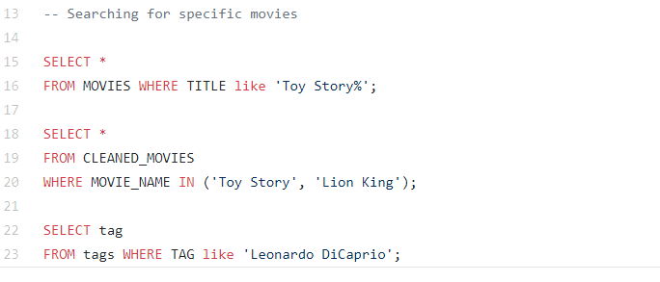
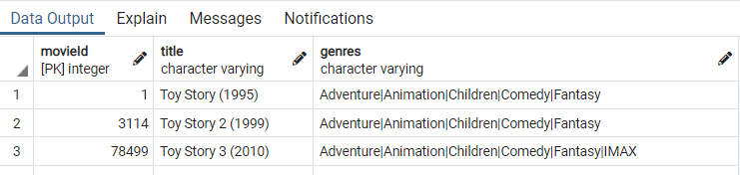
Query Analysis: (3) Obtaining results by querying specified criteria (movie title or tag) [PostgresSQL]
Output for Toy Story

Slide 21
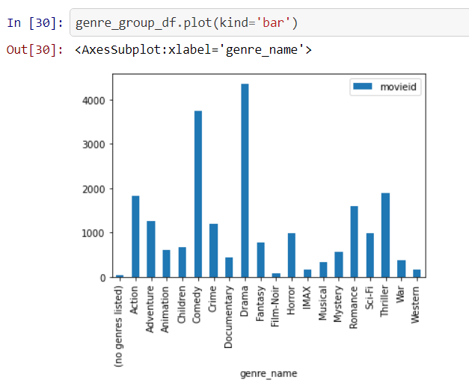
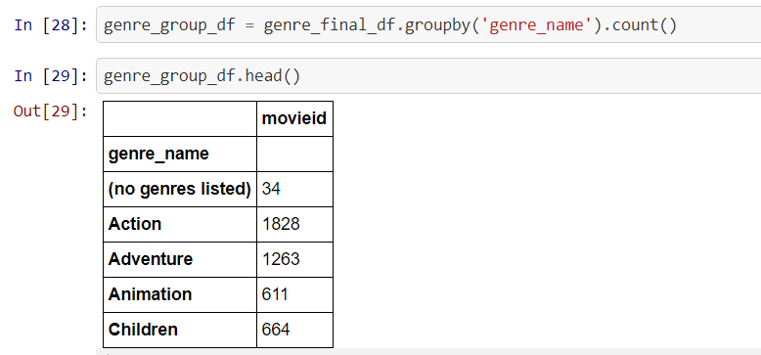
Query Analysis: (4) What is the distribution of movies according to genre category(bar chart)? [Pandas]

Slide 22
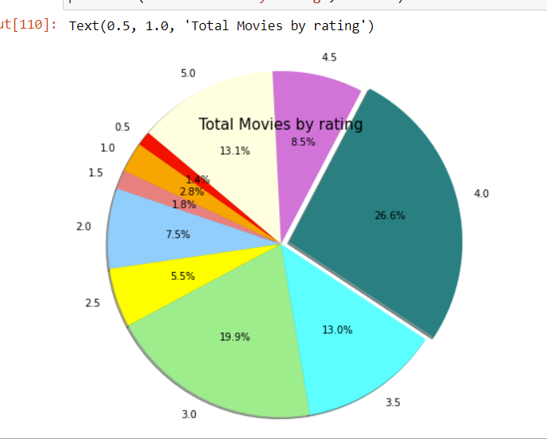
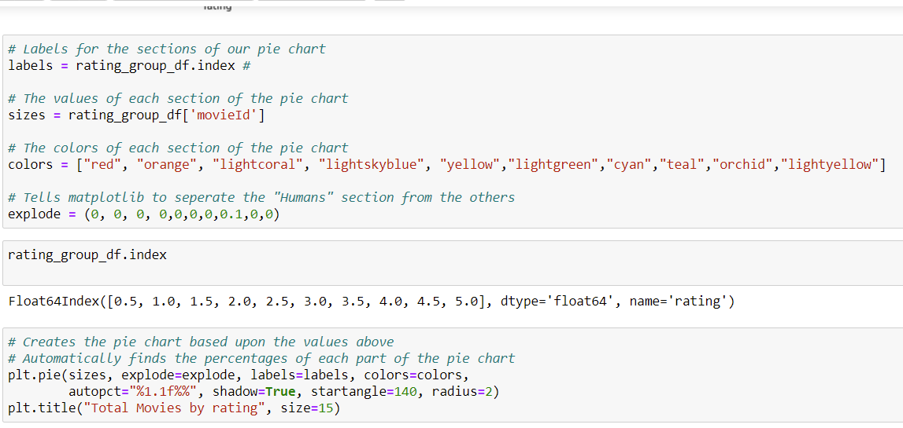
Query Analysis: (5) What is the proportionality of ratings amongst total movies rated (pie)? [Pandas]

